Slide 1
FindMe
Chiranthan Mirle - 1001011399
Abhishek Agarwal - 1000987331
Ranjith M A - 1000969864
Ather Mohammed - 1000993284
Bhavana Nandyala - 1000859140

Slide 2
Vision
To build an interactive, new generation search assistant which helps us find people and places through the touch of a button.

Slide 3

Where am I?

Slide 4

Where's my friend?

Slide 5

Solutions to the problems
To reach a destination you need two parameters

Slide 6

Direction
To know where you are and to proceed to your destination

Slide 7

Distance
After learning the direction, how far should you travel in that particular direction?

Slide 8

I Will use “FindMe”

Slide 9
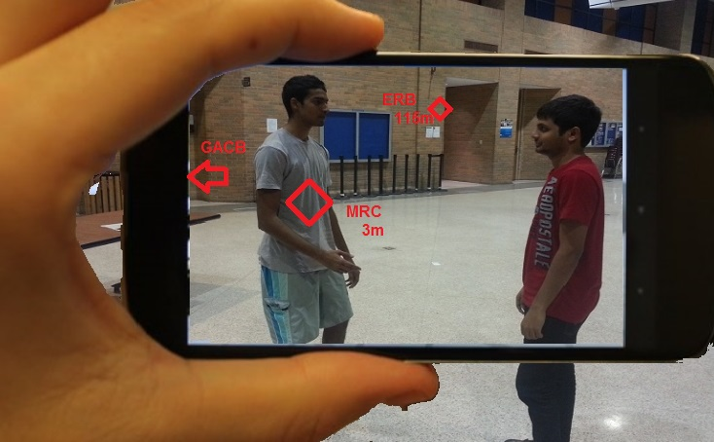
Now this is just what I want!!!

Slide 10

What tools do we use?

Slide 11
Tools that help us in development

Slide 12

GitHub

Slide 13


Android Development Tools
With AVD

Slide 14
How does the device support us?

Slide 15



Slide 16

Compass

Slide 17
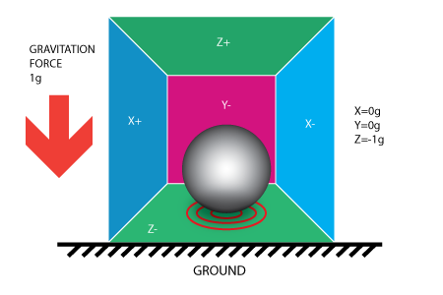
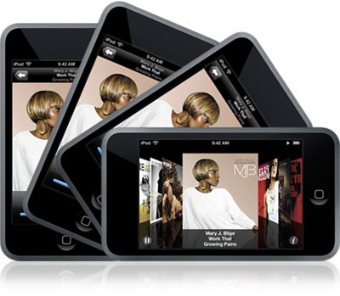
Accelerometer

Slide 18
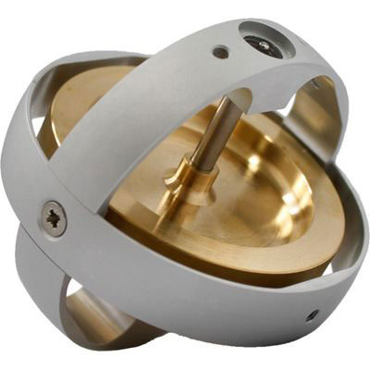
Gyroscope

Slide 19
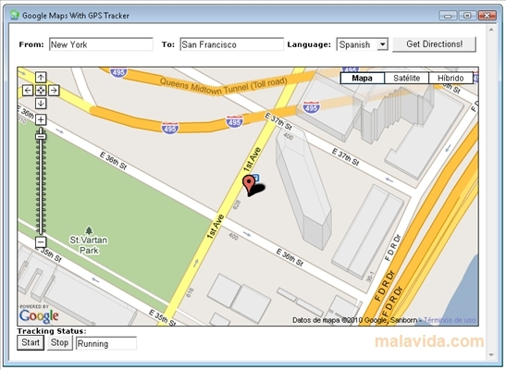

COMPETITORS
Google Maps
AcrossAir

Slide 20
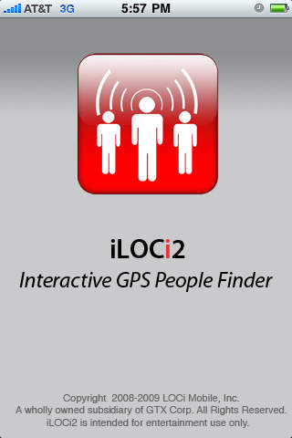
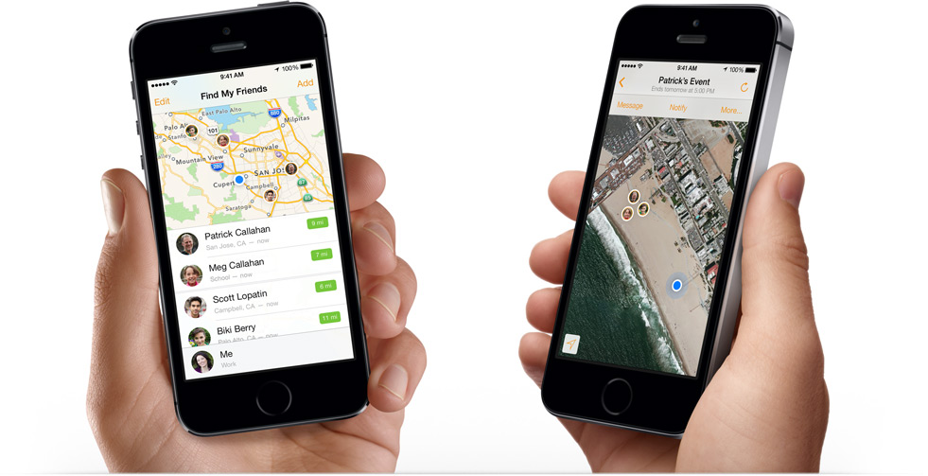

Slide 21
FUTURE SCOPE
New students can explore!
Can go global.

